Slide 1
Introduction to Quantum Alhorithms
Dr. Thyagaraju G S
Professor and HoD, Department of CSE,
SDM Institute Of Technology, Ujire-574240

Slide 2
Topics :
Introduction
Types
Example

Slide 3
Quantum Algorithms
Quantum algorithms are procedures that run on quantum computers and take advantage of quantum mechanics' principles to solve problems more efficiently than classical algorithms.
These algorithms utilize the unique properties of quantum bits (qubits), such as superposition, entanglement, and interference, to perform computations that are infeasible or extremely slow on classical computers.

Slide 4
Types of Quantum Algorithms
Quantum Search Algorithms:
Quantum Factoring Algorithms
Quantum Simulation Algorithms:
Quantum Optimization Algorithms
Quantum Machine Learning Algorithms:
Quantum Fourier Transform (QFT):
Quantum Cryptography Algorithms

Slide 5
1. Quantum Search Algorithms:
Grover's Algorithm: One of the most famous quantum algorithms, Grover's algorithm provides a quadratic speedup for unstructured search problems.
For example, if a classical algorithm needs N steps to search a list of N items, Grover's algorithm can do it in sqrt(N)​ steps.

Slide 6
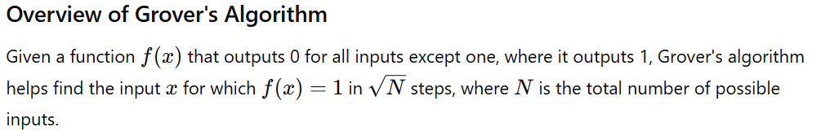
Grover’s Algorithm
Grover's algorithm is a quantum algorithm that provides a significant speedup for searching an unsorted database or solving unstructured search problems. It is particularly known for its quadratic speedup compared to classical algorithms.

Slide 7
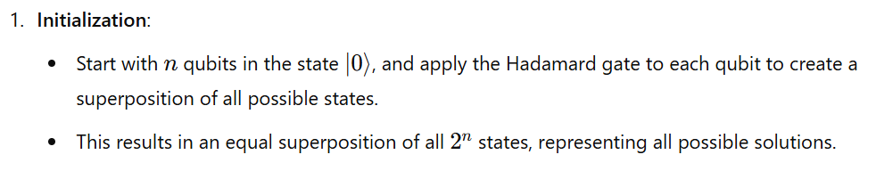
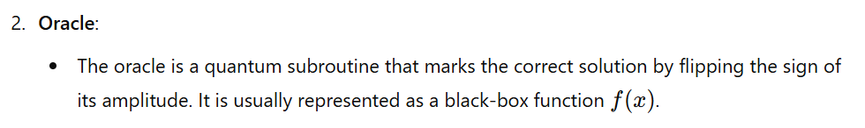
Steps of Grover's Algorithm

Slide 8
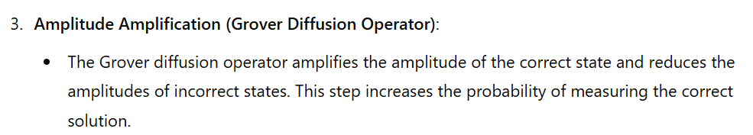
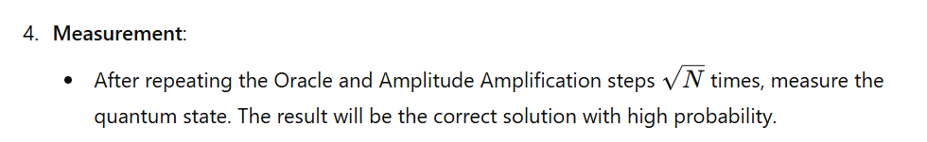
Steps of Grover's Algorithm

Slide 9
Example: Searching a Database

Slide 10
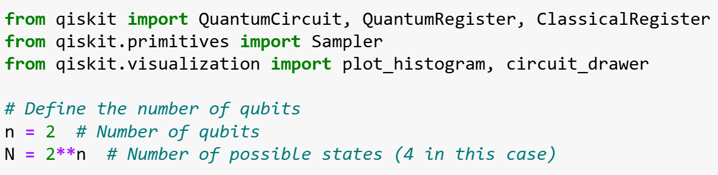

Slide 11
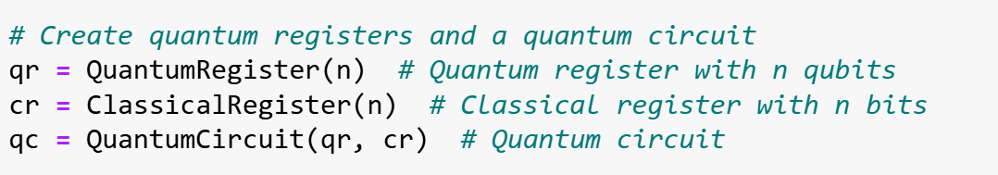

Slide 12
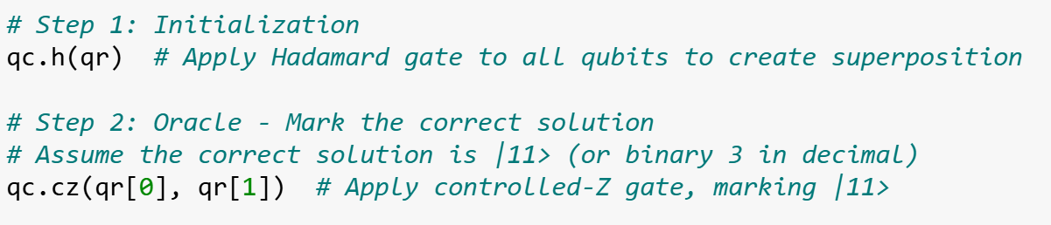

Slide 13
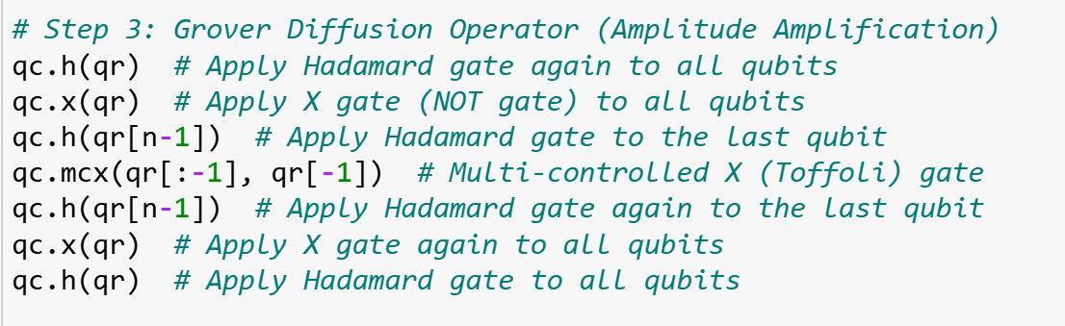
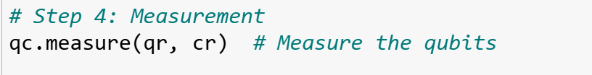

Slide 14
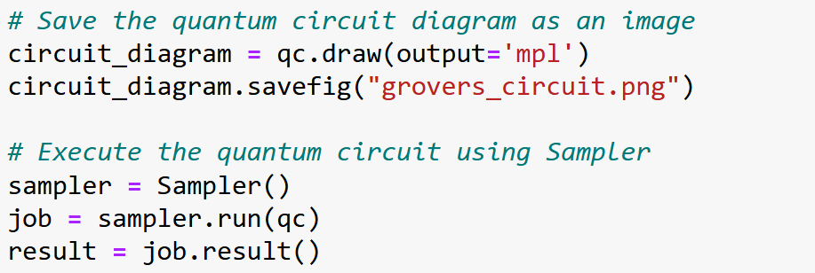

Slide 15
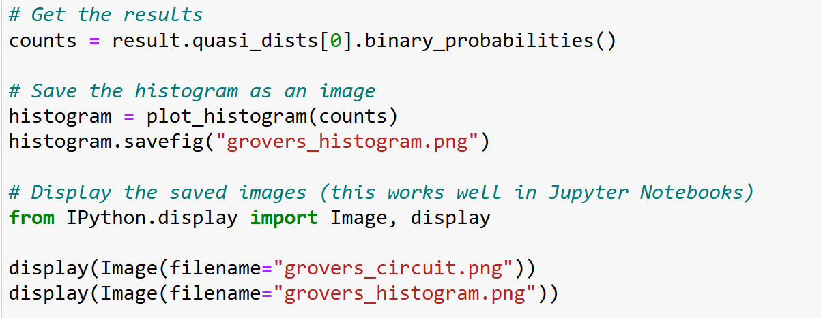

Slide 16
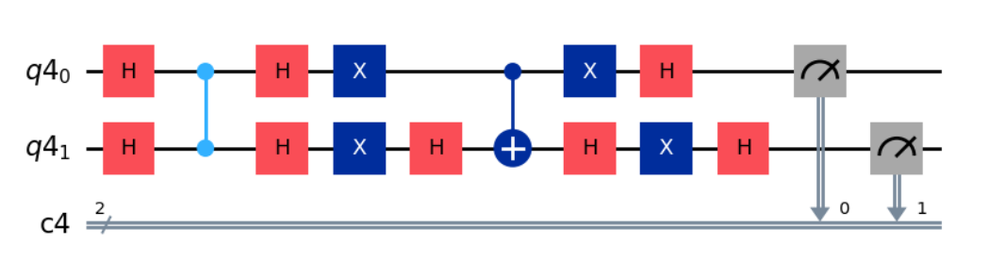

Slide 17
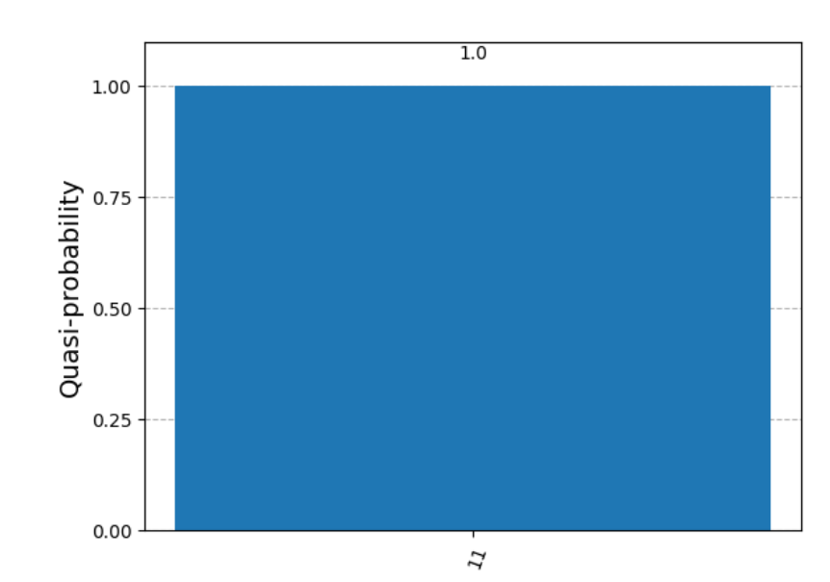

Slide 18
2. Quantum Factoring Algorithms:
Shor's Algorithm: This algorithm can factor large integers exponentially faster than the best-known classical algorithms. It's particularly significant because it could potentially break widely used cryptographic systems like RSA, which relies on the difficulty of factoring large numbers.

Slide 19
3. Quantum Simulation Algorithms:
Quantum Simulations: Quantum computers can simulate quantum systems much more efficiently than classical computers. Algorithms in this category are used to model molecular structures, chemical reactions, and other quantum systems, which has applications in materials science, chemistry, and drug discovery.

Slide 20
4. Quantum Optimization Algorithms:
Quantum Approximate Optimization Algorithm (QAOA): This algorithm is used to solve combinatorial optimization problems by finding approximate solutions more efficiently than classical methods.
Variational Quantum Eigensolver (VQE): VQE is used to find the ground state energy of a quantum system, which is crucial in quantum chemistry.

Slide 21
5. Quantum Machine Learning Algorithms
Quantum Support Vector Machine (QSVM): An adaptation of classical support vector machines, QSVMs leverage quantum computing to classify data points more efficiently.
Quantum Neural Networks (QNNs): These networks combine quantum computing with the principles of neural networks to potentially outperform classical neural networks in certain tasks.

Slide 22
6. Quantum Fourier Transform (QFT):
QFT is a quantum version of the discrete Fourier transform and is a crucial component of several quantum algorithms, including Shor's algorithm. It is used for transforming quantum states into their frequency components, which is essential in solving problems related to periodicity and number theory.

Slide 23
7. Quantum Cryptography Algorithms:
Quantum Key Distribution (QKD): QKD uses quantum mechanics to create secure communication channels, ensuring that any eavesdropping attempts can be detected. The most famous QKD protocol is BB84.

